Slide 1
Supervised Learning
Introduction, Theory, and Applications

Slide 2
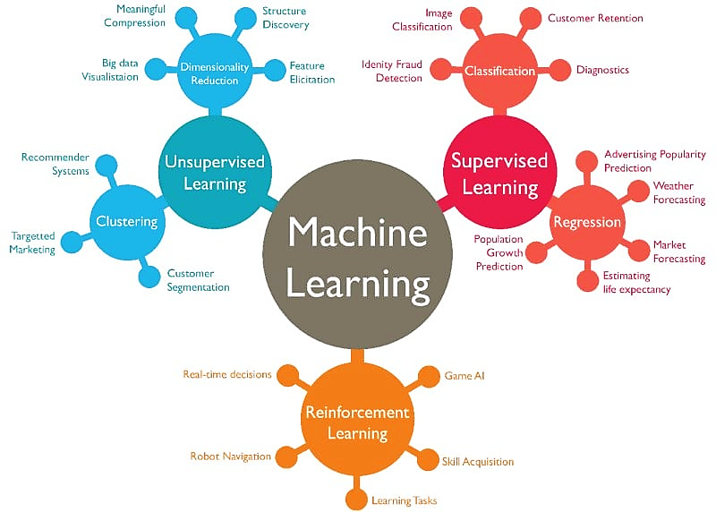
Learning
Credit : Data Science Dojo

Slide 3
Classification problems
A classification problem is a type of supervised learning where the goal is to assign each input into one of several categories or classes.
Binary Classification: Only two classes.
Example: Spam Email (Yes/No), Loan Default (Default/No Default).
Multiclass Classification: More than two classes.
Example: Handwritten digit recognition (digits 0–9).
Multilabel Classification: Each input can belong to multiple classes at once.
Example: A news article classified as “Sports” and “Politics” at the same time.
How Classification Works:
We train a model using labeled data (features + class labels).
The model learns patterns and decision boundaries.
For new input, the model predicts which class it belongs to.

Slide 4
Decision Boundaries
When we train a classifier, the algorithm learns how to separate data points of different classes.
The decision boundary is the line, curve, or surface that divides the input space into regions corresponding to different classes.
1. Linear Decision Boundary
A straight line in 2D, or a hyperplane in higher dimensions.
Works well if data is linearly separable (can be divided by a straight line).
Example: Logistic Regression, Linear SVM.
2. Non-linear Decision Boundary
More flexible; can be curved or irregular.
Needed when classes cannot be separated with a straight line.
Example: Decision Trees, Kernel SVM, Neural Networks.
Simple boundaries = better interpretability, but may underfit.
Complex boundaries = capture more detail, but risk overfitting.

Slide 5
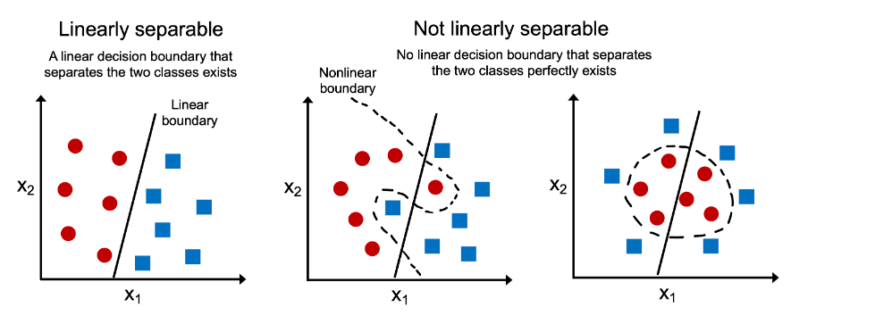
Decision Boundaries
Credit : vitalflux.com

Slide 6
Classification algorithms

Slide 7
K – Nearest Neighbour (KNN)

Slide 8
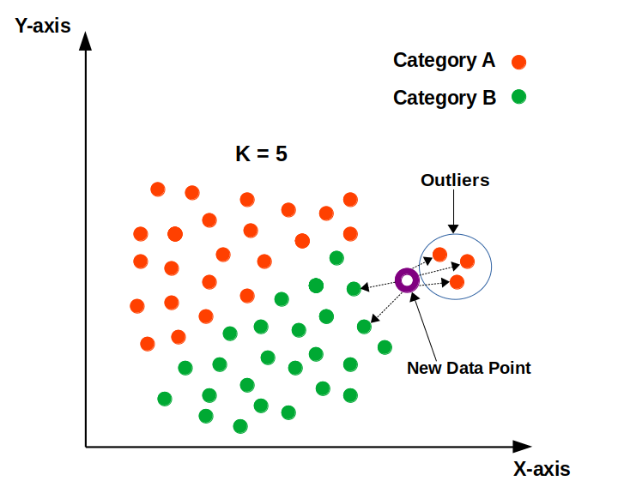
K-Nearest Neighbour (KNN)
It is an Instance-based learning.
How it Works:
Store all the training data.
For a new point to classify:
Calculate the distance (e.g., Euclidean) from the new point to all training points.
Pick the k closest points (neighbors).
Assign the class based on a majority vote among those neighbors.
Q. What other type of distances one can use ? What advantage can it provide ?
Credit : analyticsvidhya.com

Slide 9
How to choose best ‘k’
Small k (e.g., 1): Very flexible but can overfit (too sensitive to noise).
Large k: More stable but can underfit (smooths too much).
Common approach: Use cross-validation to find the best k.

Slide 10
KNN overview
Pros of KNN:
Simple to understand and implement.
No explicit training phase (lazy learner).
Works well for small datasets.
Cons of KNN:
Computationally expensive for large datasets (must compute distance to all points).
Performance drops in high-dimensional spaces (curse of dimensionality).
Sensitive to irrelevant or noisy features.
Applications of KNN:
Handwriting recognition (digits 0–9).
Recommendation systems (find similar users/items).
Medical diagnosis (find similar patient cases).

Slide 11
Linear Classifiers

Slide 12
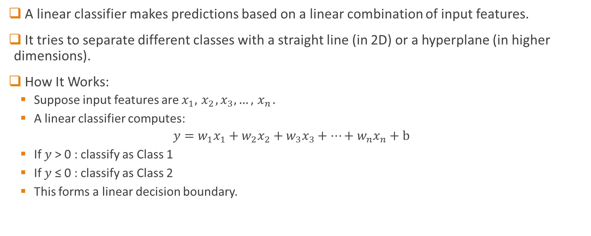
Linear Classifiers
A linear classifier makes predictions based on a linear combination of input features.
It tries to separate different classes with a straight line (in 2D) or a hyperplane (in higher dimensions).
How It Works:
Suppose input features are $x_{1},{ x}_{2},x_{3}, …,{ x}_{n}.$
A linear classifier computes:
$$y=w_{1}x_{1}+w_{2}x_{2}+w_{3}x_{3}+…+w_{n}x_{n}+b$$
If 𝑦 > 0 : classify as Class 1
If 𝑦 ≤ 0 : classify as Class 2
This forms a linear decision boundary.

Slide 13
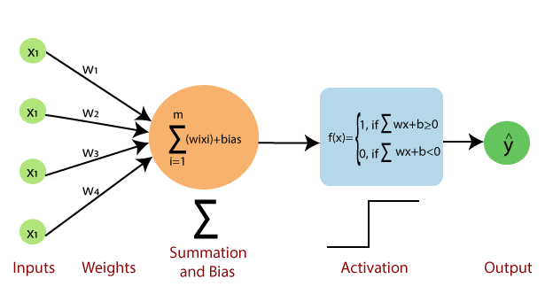
Linear classifiers - examples
Logistic Regression
Uses a sigmoid function to output probabilities.
Perceptron
Simplest neural network unit.
Learns weights by adjusting based on misclassifications.
The perceptron model
H.W. : What are other types of activation functions ?

Slide 14
Perceptron in action

Slide 15
A slight detour… Bayes’ Rule

Slide 16
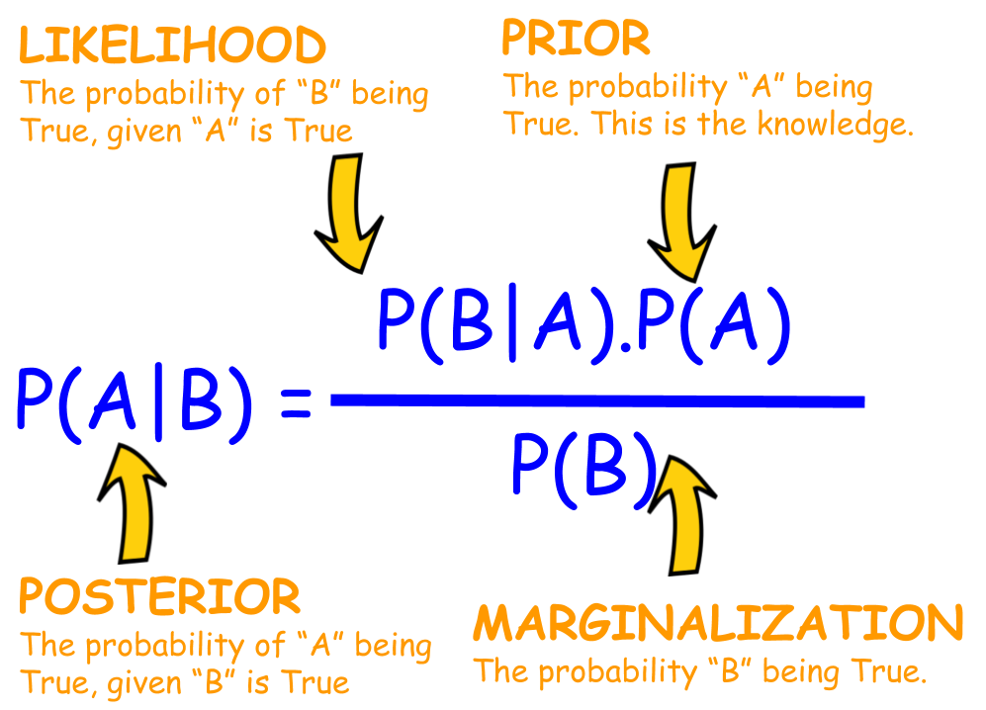
Looking back at Bayes’ Rule
How can we use Bayes’ Rule for classification tasks ?

Slide 17
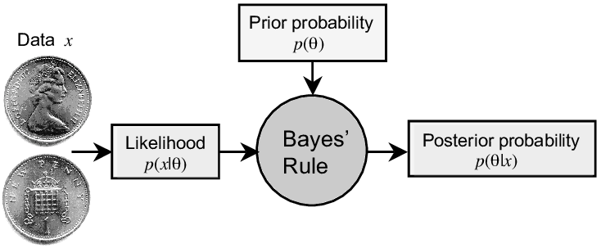
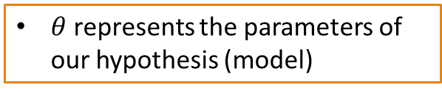
Updating beliefs with Bayes
This seemingly simple concept is at the heart of many statistical techniques such as : Bayesian curve fitting, parameter estimation problems etc.
$θ$ represents the parameters of our hypothesis (model)
Source - Stone, James. (2013). Bayes' Rule: A Tutorial Introduction to Bayesian Analysis. 10.13140/2.1.1371.6801.

Slide 18
Naïve Bayes Classifier

Slide 19
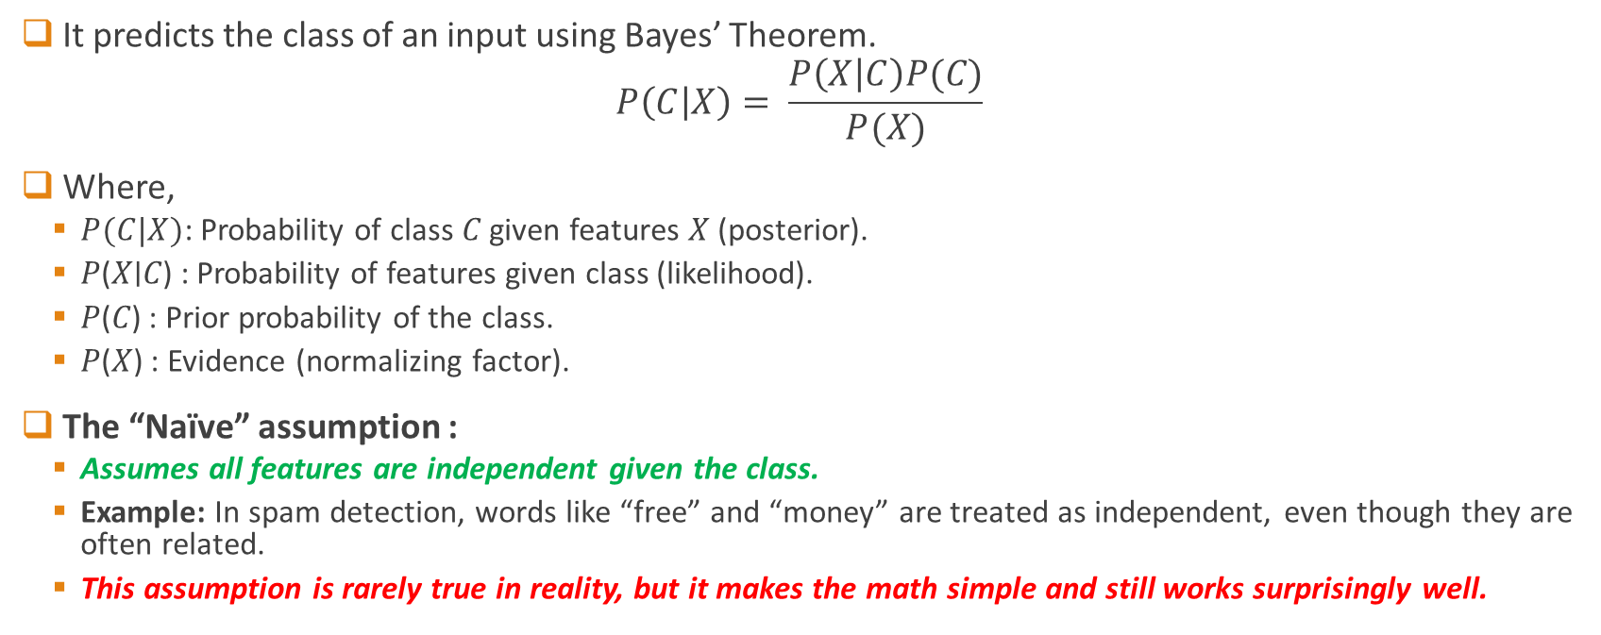
Naïve Bayes Classifier
It predicts the class of an input using Bayes’ Theorem.
$$P\left(C | X\right)= \frac{P\left(X | C\right)P(C)}{P(X)}$$
Where,
$P(C|X)$: Probability of class 𝐶 given features 𝑋 (posterior).
𝑃(𝑋∣𝐶) : Probability of features given class (likelihood).
𝑃(𝐶) : Prior probability of the class.
𝑃(𝑋) : Evidence (normalizing factor).
The “Naïve” assumption :
Assumes all features are independent given the class.
Example: In spam detection, words like “free” and “money” are treated as independent, even though they are often related.
This assumption is rarely true in reality, but it makes the math simple and still works surprisingly well.

Slide 20

Example
Email Text | Contains “Free” | Contains “Win” | Class (Spam/Not Spam)
"Win a free iPhone" | Yes | Yes | Spam
"Meeting at office" | No | No | Not Spam
"Win money now" | No | Yes | Spam
"Free lunch offer" | Yes | No | Spam
"Project discussion" | No | No | Not Spam
Calculate Likelihoods
(How often a word appears in Spam vs Not Spam emails)
Contains "Free":
In Spam = 2/3
In Not Spam = 0/2
Contains "Win":
In Spam = 2/3
In Not Spam = 0/2
Calculate Priors
Total emails = 5
Spam = 3, Not Spam = 2

Slide 21
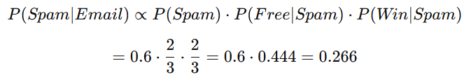

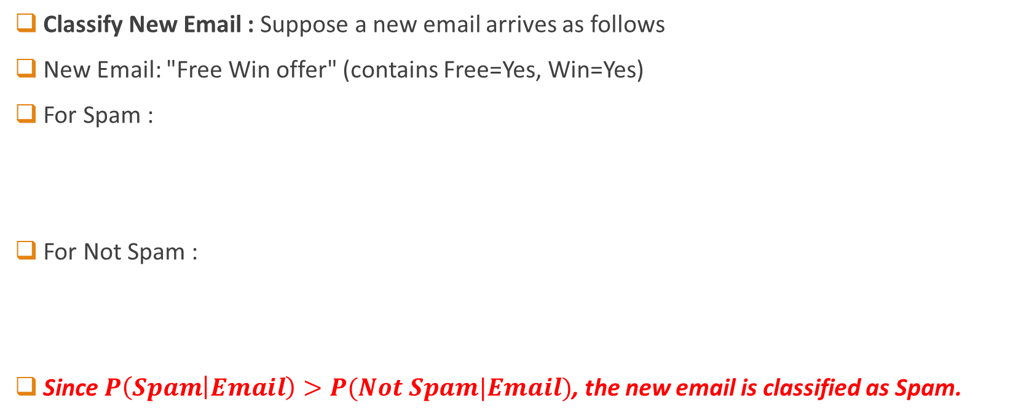
Example - continued
Classify New Email : Suppose a new email arrives as follows
New Email: "Free Win offer" (contains Free=Yes, Win=Yes)
For Spam :
For Not Spam :
Since $P\left(Spam | Email\right)>P(Not Spam|Email)$, the new email is classified as Spam.

Slide 22
Support Vector Machine

Slide 23
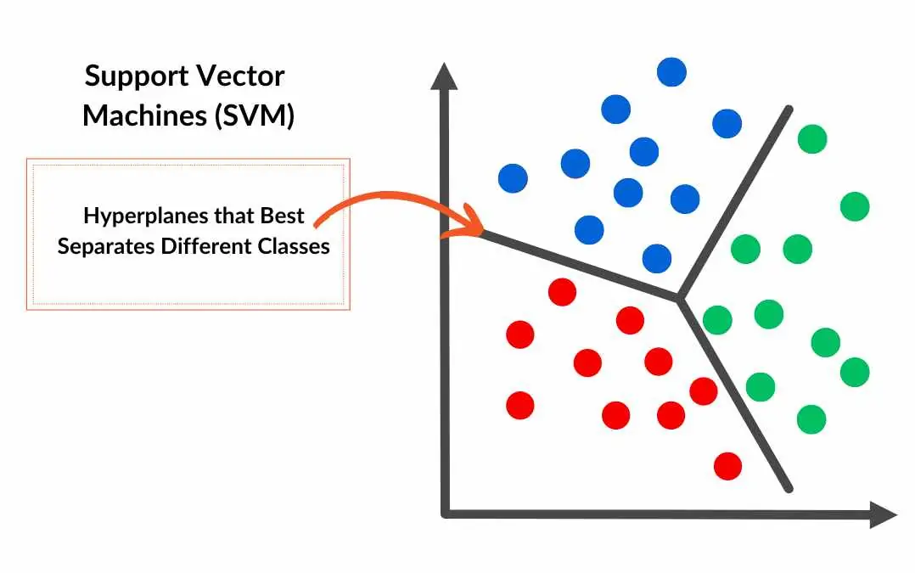

Support Vector Machine
Support Vector Machines (SVMs) are a type of supervised machine learning algorithm used for classification and regression tasks.
They are widely used in various fields, including pattern recognition, image analysis, and natural language processing.
SVMs work by finding the optimal hyperplane that separates data points into different classes.
Recall that the classification is done by separating instances in different classes/labels in feature space.
“The feature space is the main playground here.”
Before moving further let us clarify basic terminologies involved

Slide 24
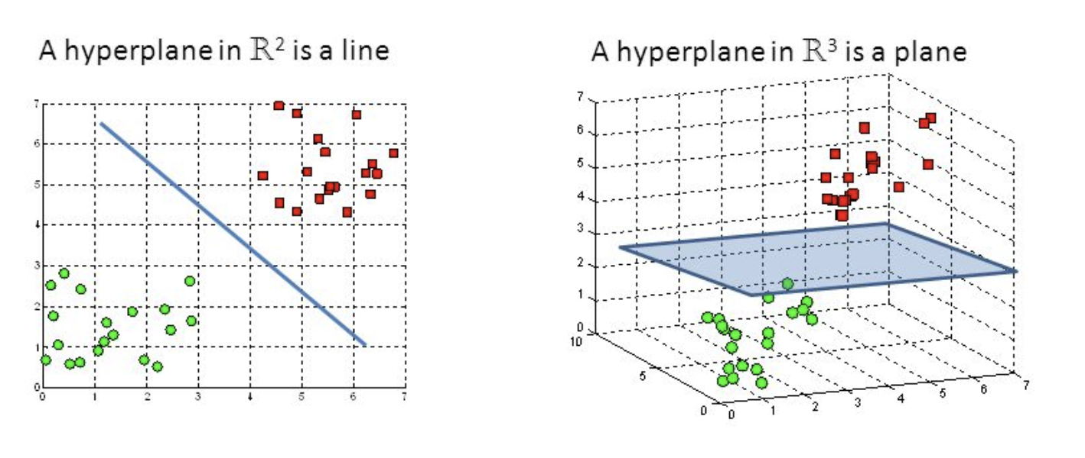
Hyperplane
Definition : A hyperplane separates data points into different classes in high-dimensional space.
Examples :
2D → Line separating classes
3D → Plane separating classes
N-D → (N-1)-dimensional surface
Usage :
Predicts class of new data by checking which side of the hyperplane it lies on
One side → Class A
Other side → Class B

Slide 25
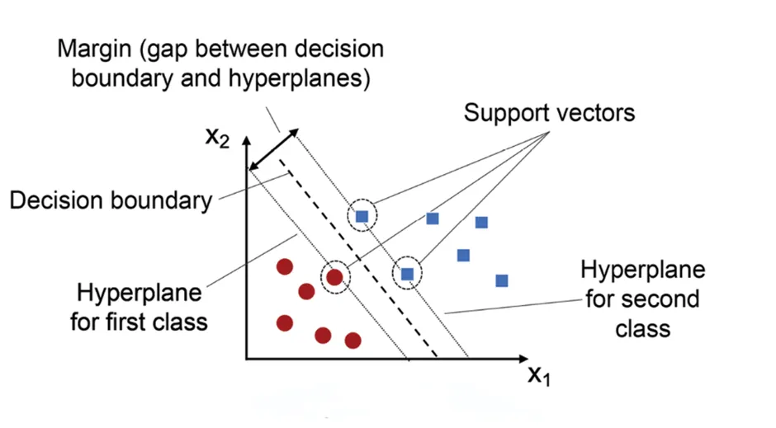
Margins
Definition : Distance between the decision boundary (hyperplane) and the closest data points from each class
Goal of SVMs => Maximize margin while minimizing classification errors
Significance :
Larger margin → Higher confidence in classification
Margin = Measure of how well-separated the classes are in feature space
SVMs find the hyperplane that maximizes the margin.
Hence called maximum-margin classifiers

Slide 26
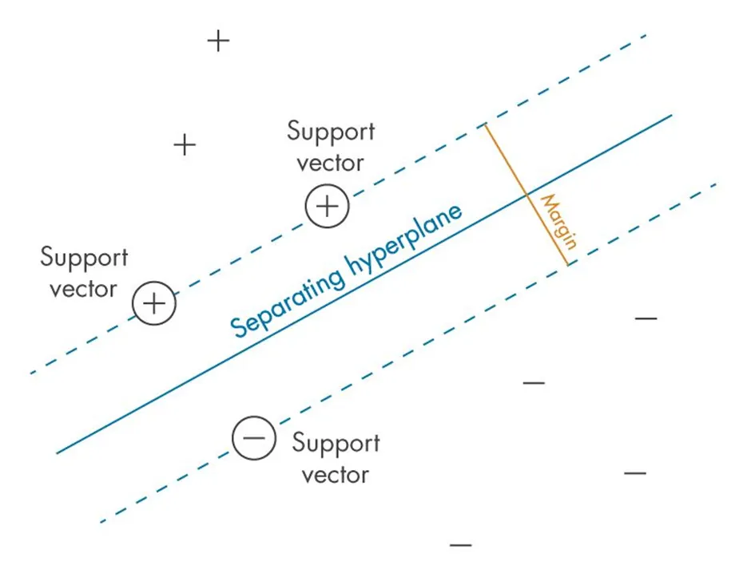
Support Vectors
Definition : Data points that lie closest to the decision boundary (hyperplane)
Importance :
Determine the position and orientation of the hyperplane
Directly impact classification accuracy
Role in SVMs :
SVMs are named after support vectors because they “support” the decision boundary
Used to calculate the margin (distance between hyperplane & closest data points)

Slide 27
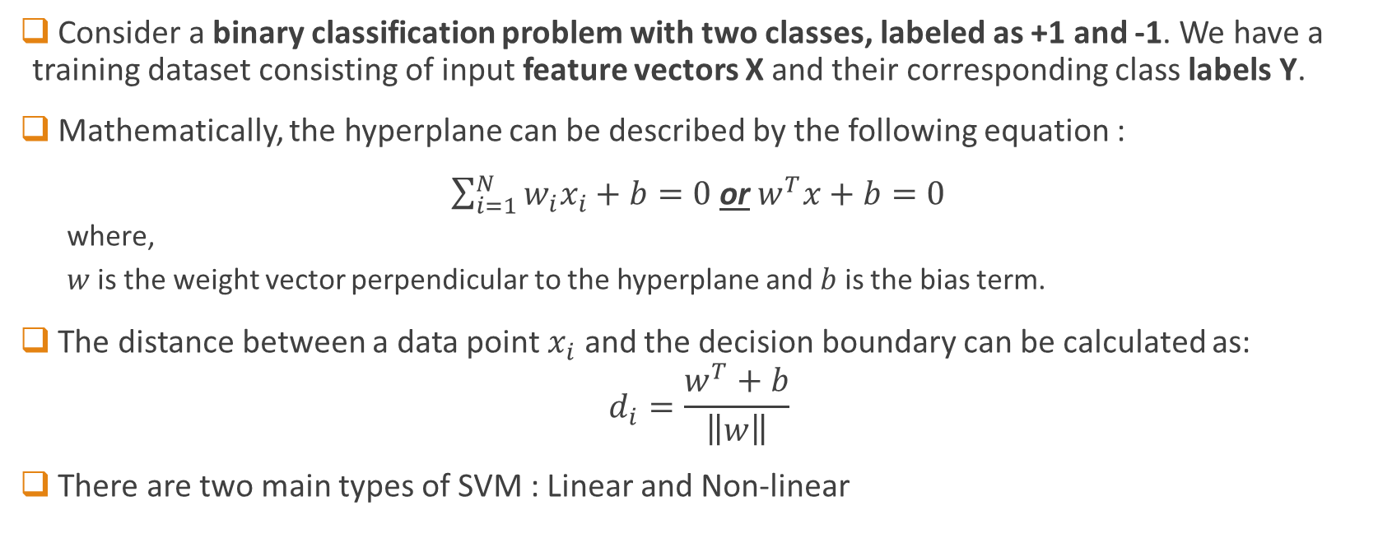
Mathematics of SVM
Consider a binary classification problem with two classes, labeled as +1 and -1. We have a training dataset consisting of input feature vectors X and their corresponding class labels Y.
Mathematically, the hyperplane can be described by the following equation :
$\sum_{i=1}^{N}{w_{i}x_{i}+b}=0$ or $w^{T}x+b=0$
where,
$w$ is the weight vector perpendicular to the hyperplane and $b$ is the bias term.
The distance between a data point $x_{i}$ and the decision boundary can be calculated as:
$$d_{i}=\frac{w^{T}+b}{\left\|w\right\|}$$
There are two main types of SVM : Linear and Non-linear

Slide 28
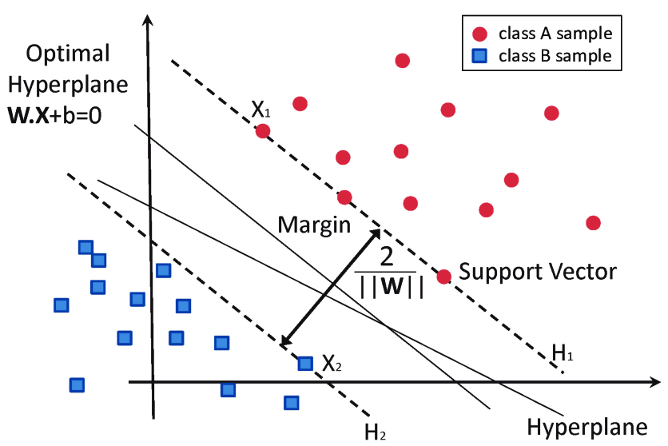
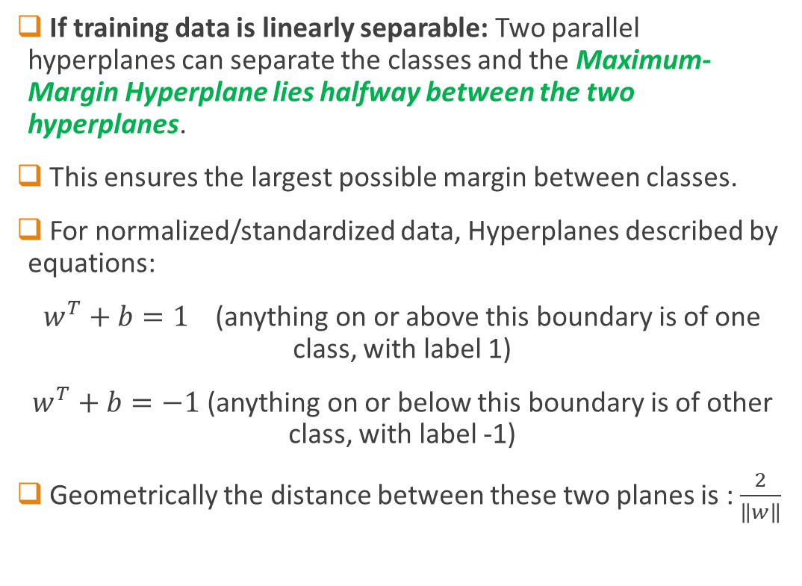
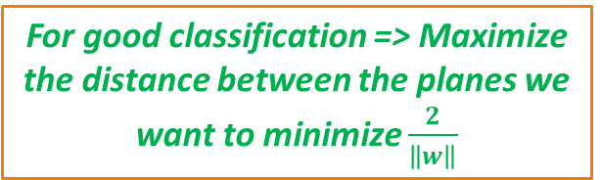
Linear SVM – Hard Margin
If training data is linearly separable: Two parallel hyperplanes can separate the classes and the Maximum-Margin Hyperplane lies halfway between the two hyperplanes.
This ensures the largest possible margin between classes.
For normalized/standardized data, Hyperplanes described by equations:
$w^{T}+b=1$ (anything on or above this boundary is of one class, with label 1)
$w^{T}+b=−1$ (anything on or below this boundary is of other class, with label -1)
Geometrically the distance between these two planes is : $\frac{2}{\left\|w\right\|}$
For good classification => Maximize the distance between the planes we want to minimize $\frac{2}{\left\|w\right\|}$

Slide 29

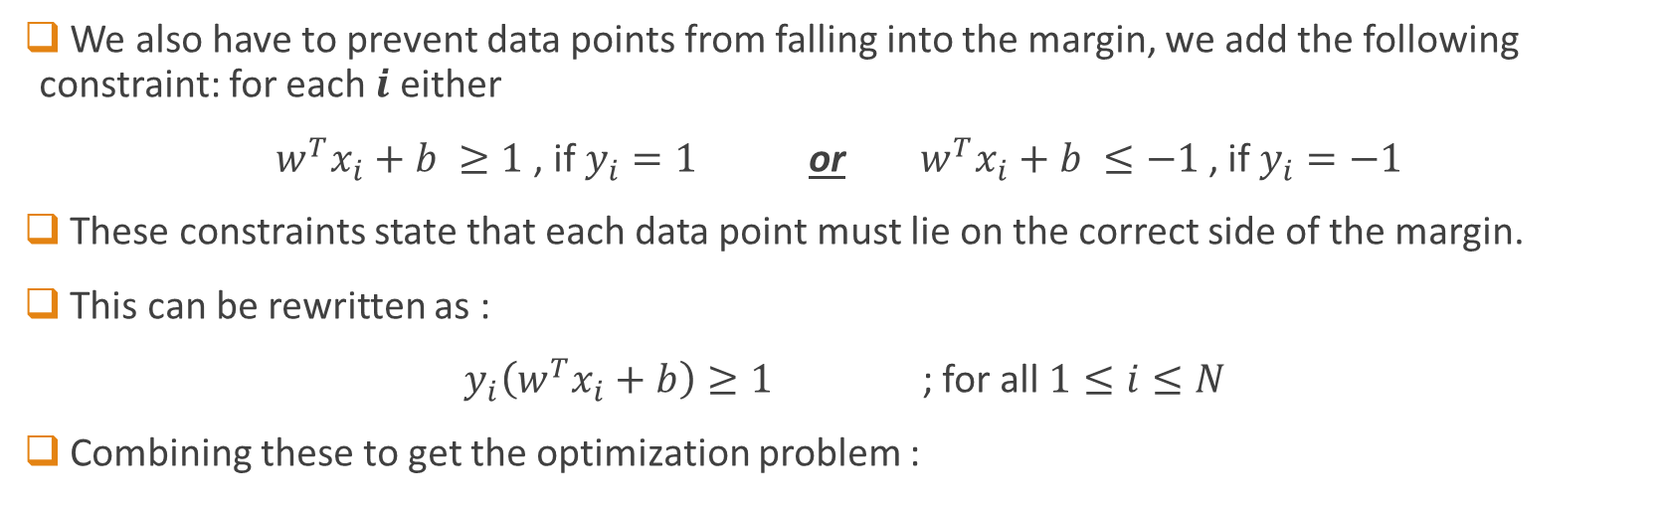

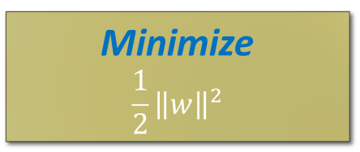
Linear SVM – Hard Margin
We also have to prevent data points from falling into the margin, we add the following constraint: for each $i$ either
$w^{T}x_{i}+b ≥1$, if $y_{i}=1$ or $w^{T}x_{i}+b ≤−1$, if $y_{i}=−1$
These constraints state that each data point must lie on the correct side of the margin.
This can be rewritten as :
$y_{i}\left(w^{T}x_{i}+b\right)≥1$ ; for all $1≤i≤N$
Combining these to get the optimization problem :
Recall, $y_{i}∈\{−1,1\}$
Minimize
$$\frac{1}{2}{\left\|w\right\|}^{2}$$
This is how SVM “learns”
subject to $y_{i}\left(w^{T}x_{i}+b\right)≥1$; for all $1≤i≤N$

Slide 30
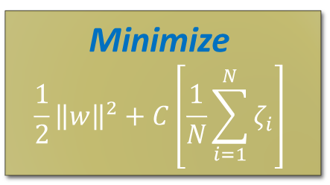
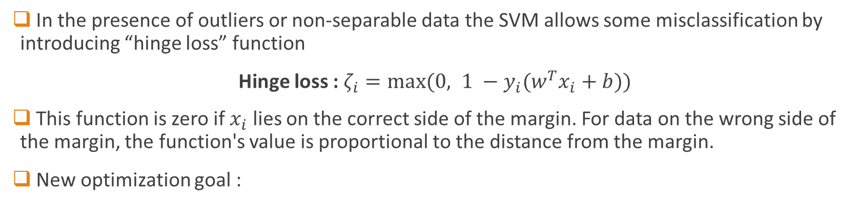
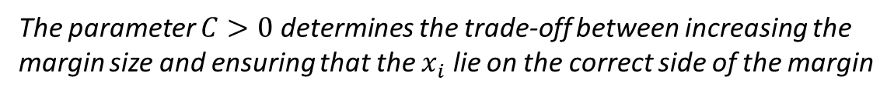
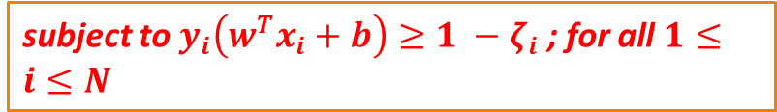
Linear SVM – Soft Margin
In the presence of outliers or non-separable data the SVM allows some misclassification by introducing “hinge loss” function
Hinge loss : $ζ_{i}=max⁡(0, 1 −y_{i}(w^{T}x_{i}+b))$
This function is zero if $x_{i}$ lies on the correct side of the margin. For data on the wrong side of the margin, the function's value is proportional to the distance from the margin.
New optimization goal :
Minimize
$$\frac{1}{2}{\left\|w\right\|}^{2}+C\left[\frac{1}{N}\sum_{i=1}^{N}{ζ_{i}}\right]$$
subject to $y_{i}\left(w^{T}x_{i}+b\right)≥1 −ζ_{i}$; for all $1≤i≤N$
Objective function
The parameter $C>0$ determines the trade-off between increasing the margin size and ensuring that the $x_{i}$ lie on the correct side of the margin
H.W. : Show that for large 𝐶 , soft margin SVM acts like a hard-margin SVM but still tests rule viability.

Slide 31
What if data is not linearly separable ?
Make it separable anyway – somehow
Or in better words…
“Transform the data so that it becomes separable”

Slide 32
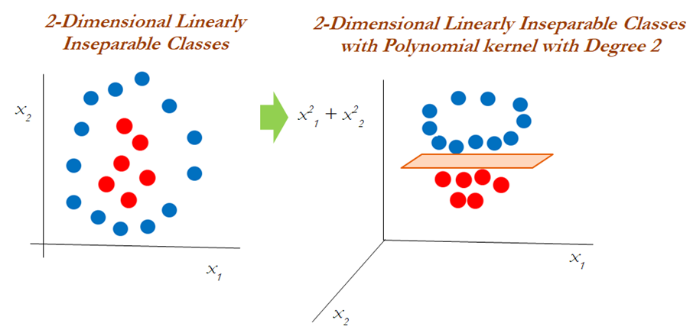
Non Linear SVM
When data is not linearly separable
SVM uses kernels to map data to a higher-dimensional space
In this space, data becomes separable
Enables SVM to find a decision boundary for non-linear data
Kernel Trick

Slide 33
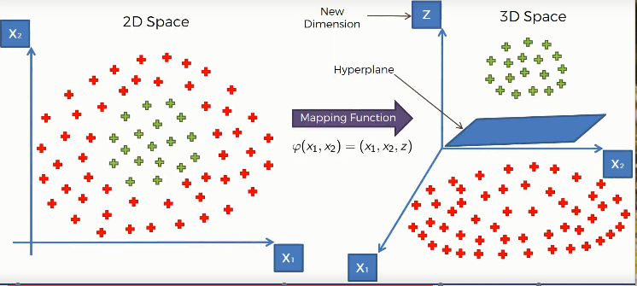
Kernel trick
A kernel maps data into a higher-dimensional space without explicitly computing the coordinates, enabling SVM to handle non-linear data efficiently.
It implicitly transforms non-separable data into a space where it becomes linearly separable.
Common Kernels:
Linear Kernel – for linearly separable data
Polynomial Kernel – maps data into polynomial feature space
RBF Kernel – separates data based on pairwise distances

